Slide 1
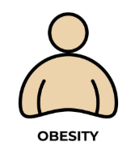


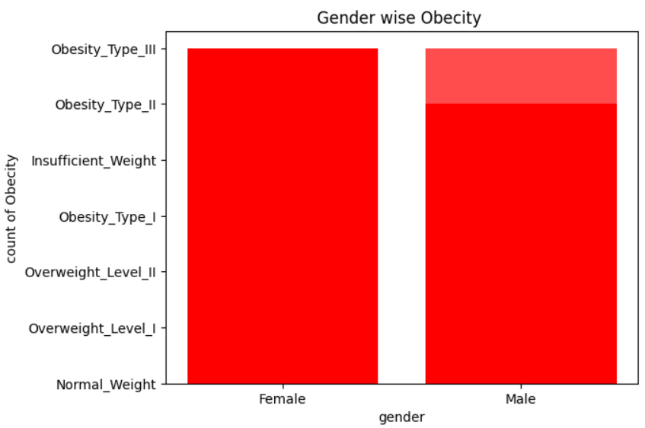
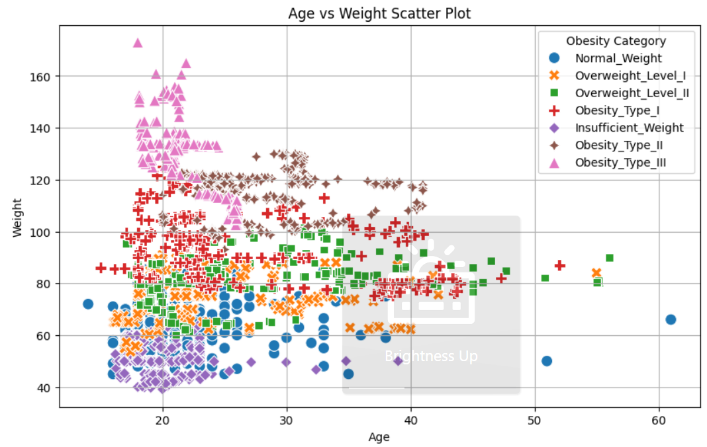
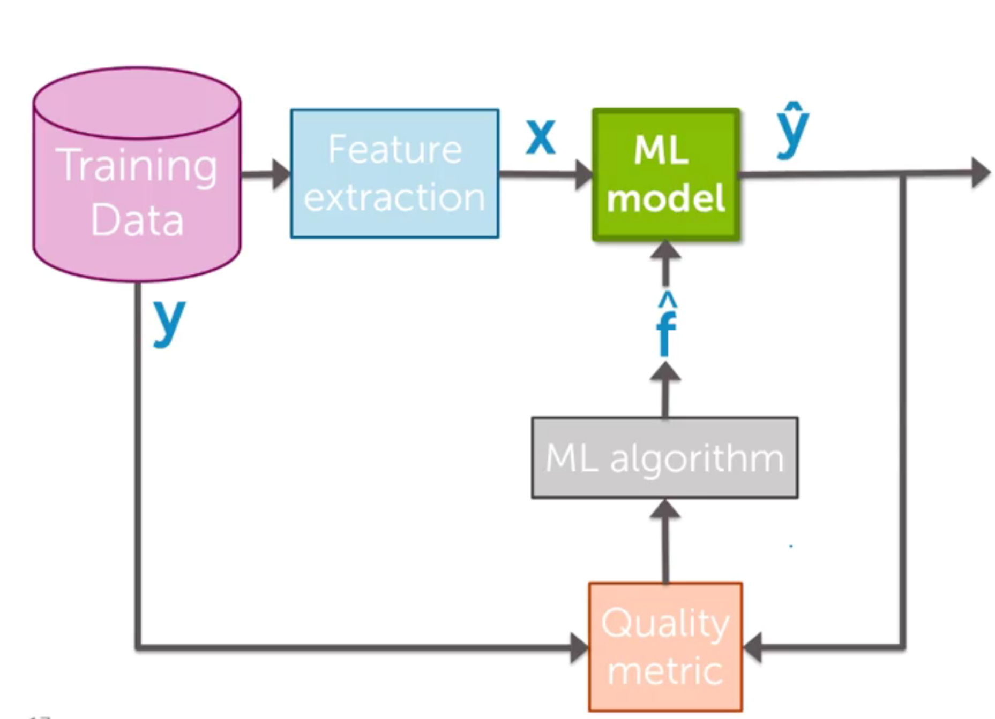
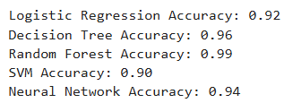
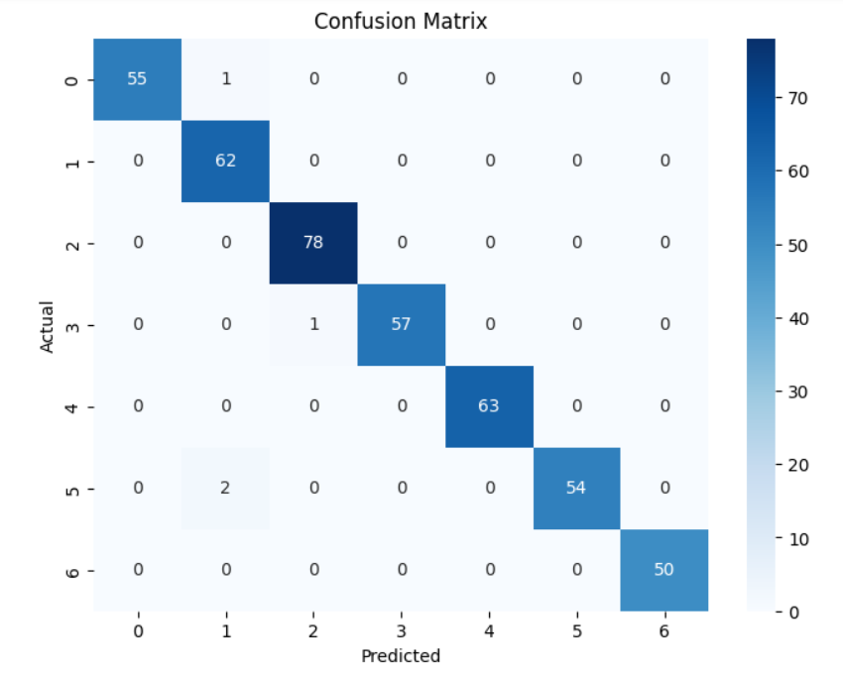
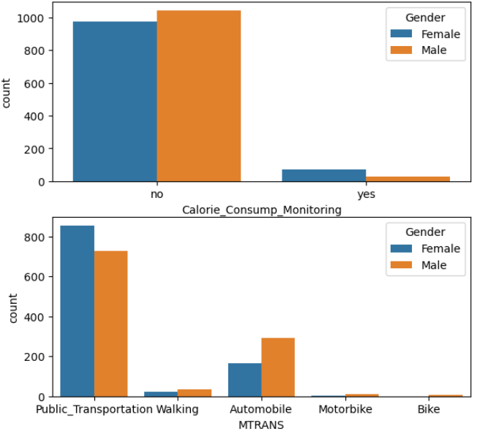
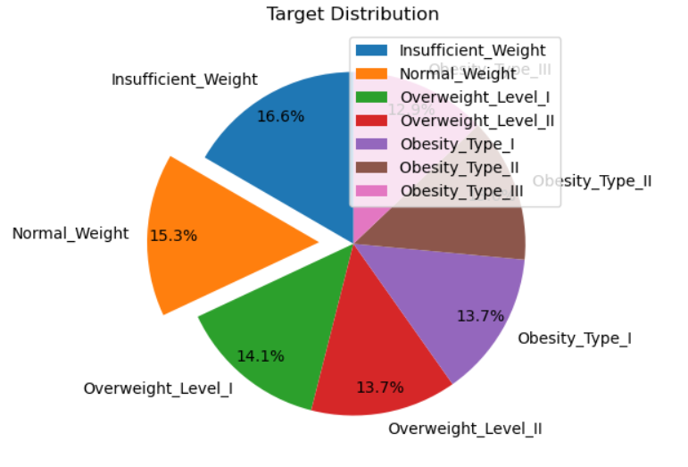
Rayat Shikshan Santha’s
Yashavantrao Chavan Institute of Science, Satara
Lead College Karmaveer Bhaurao Patil University, Satara, Maharashtra, India
Estimation of Obesity Levels Based on Eating Habits and Physical Condition
K. A. Jarhad, T. V. Beloshe
ABSTRACT
METHEDOLOGY
ANALYSIS
CONCLUSIONS
Obesity is a global health concern with significant health implications. This study focuses on using machine learning to predict obesity levels based on eating habits, physical activity, and other lifestyle factors. Various models, like Logistic Regression, Decision Trees, Random Forest, SVM, and Neural Networks, were trained on demographic and lifestyle data. The analysis revealed key factors influencing obesity risk. The findings highlight the effectiveness of machine learning in predicting obesity and understanding the impact of lifestyle choices.
Data Collection
Data Preprocessing
Model Selection and Training
Model Selection: Explore a range of machine learning algorithms, including: Logistic Regression
Decision Tree Classifier
Random Forest Classifier
Support Vector Machine (SVM)
Neural Networks
Model Training: Train the selected models on the training data using appropriate hyperparameter tuning techniques.
4. Model Evaluation
Confusion Matrix: Analyze the confusion matrix to understand model strengths and weaknesses.
Model Comparison: Compare the performance of different machine learning models and select the best-performing model.
Feature Importance Interpretation: Analyze the identified key predictors and their relationship with obesity.
Risk Stratification: Explore the potential of the model to stratify individuals into different risk categories for obesity
Present the performance of the best-performing machine learning model.
Discuss the identified key predictors of obesity.
INTRODUCTION
FUTURE SCOPE
Obesity is a major public health issue, increasing the risk of chronic diseases like heart disease, diabetes, and cancer.
This project aims to investigate whether machine learning techniques can effectively predict obesity levels in individuals based on their eating habits, physical activity patterns, and other relevant lifestyle factors.
Incorporate broader factors (socioeconomic, environmental, etc.) into machine learning models for more accurate obesity estimation.
Investigate long-term effects: Conduct longitudinal studies to analyze the long-term impact of lifestyle changes on obesity levels and refine the model's predictive power over time.
LIMITATIONS
OBJECTIVES
RESULTS
1. The dataset is limited to individuals from Mexico, Peru, and Colombia, potentially limiting the generalizability of the findings to populations with different dietary and lifestyle habits, such as India
.2. Individual variability: Physiological differences and genetic factors can influence obesity differently in each individual, limiting the generalizability of the model.
Develop and evaluate machine learning models to predict obesity levels based on individual characteristics and lifestyle factors.
Investigate the potential of the model for personalized obesity risk assessment and intervention planning.
Identify the most significant predictors of obesity from the available data.
REFERENCES
https://www.who.int/data/gho/data/themes/topics/topic-details/GHO/body-mass-index
https://pmc.ncbi.nlm.nih.gov/articles/PMC10343820/
https://link.springer.com/article/10.1186/1475-2891-9-39
Figure – Count plot of Calorie monitoring and Mode of transportation

